Slide 1
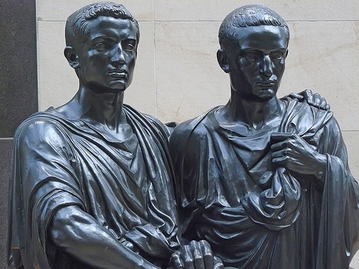
The Gracchi
Tiberius Sempronius Gracchus (163-133 BCE)
Gaius Sempronius Gracchus (c. 154-121 BCE)

Slide 2
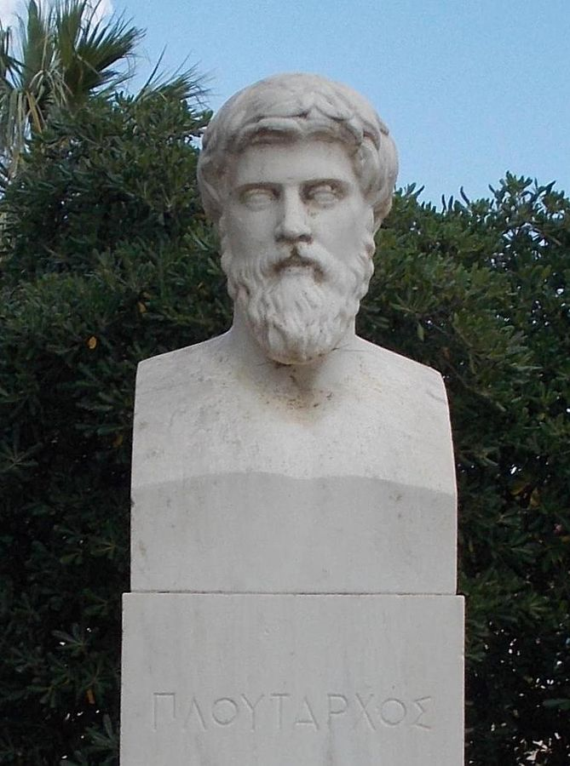
Plutarch
c. 45-125 CE
Born in Chaeronea, Greece
Local official and priest at Delphi
Wrote moralizing essays and Parallel Lives, comparing a Roman statesman to a Greek
Interested in morality and behavior, but had access to many lost sources

Slide 3
Appian and Velleius Paterculus
Appian
Velleius Paterculus
c. 90-165 CE, from Egypt
Wrote Roman History in Greek for a Greek audience
Books on the civil war survive
c. 19 BCE-31 CE
Senator with extensive military experience
Wrote Universal History, which survives in only two books
“the historical inaccuracies, evident bias, and unabashed panegyric have tarnished its reputation among modern historians”

Slide 4
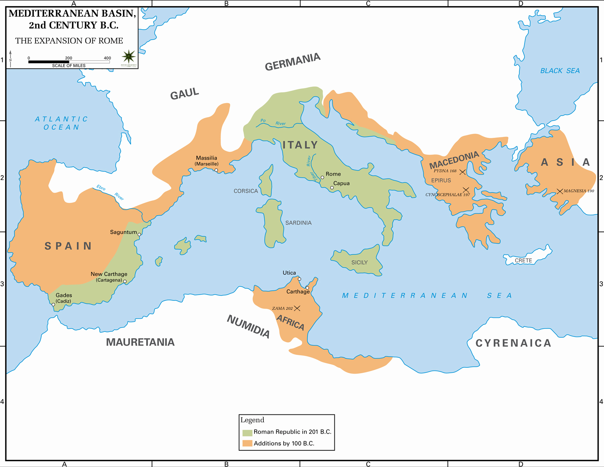

Slide 5
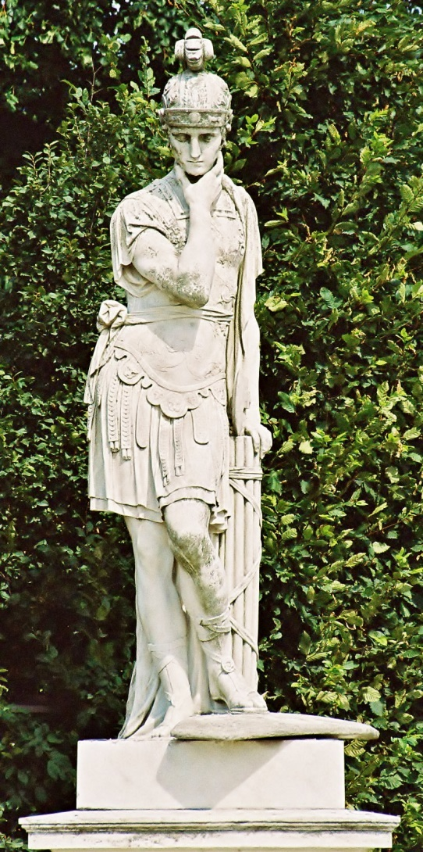
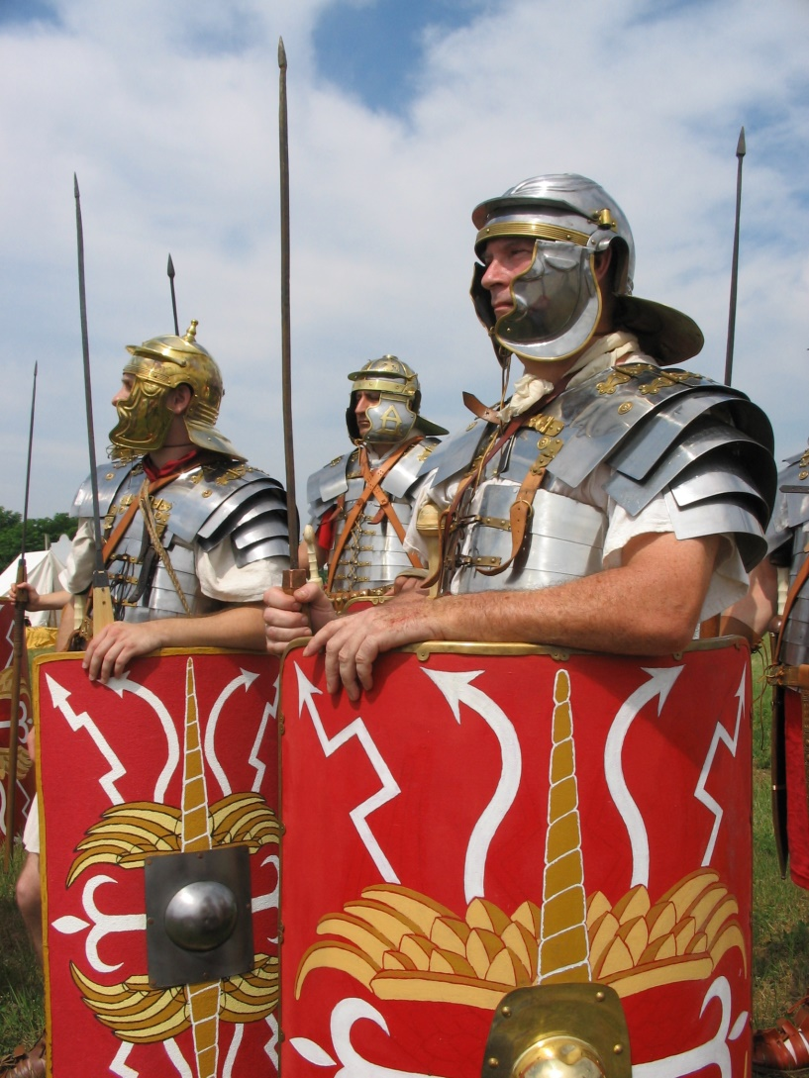
Causes for Roman Expansion
Quintus Fabius Maximus Verrucosus Cunctator (cos 233, 228, 215, 214, 209 BCE)
Roman Legionary reenactors

Slide 6
Servius Tullius’ Army
Livy 2.42-3
Divided Roman male population into five classes
100,000 asses (big bronze coins)
75,000 asses
50,000 asses
25,000 asses
11,000 asses
Organized into 193 centuries of 100 men commanded by a centurion

Slide 7
The Census
Made every five years
All adult male citizens had to register themselves and their wives, children, other dependent relatives, and slaves
Also had to list all property and its value
Similar censuses performed in allied Italian cities
Provided basis for levying armies

Slide 8
Problems
Long foreign postings
Immigration to Rome

Slide 9
155-133 BCE

Slide 10
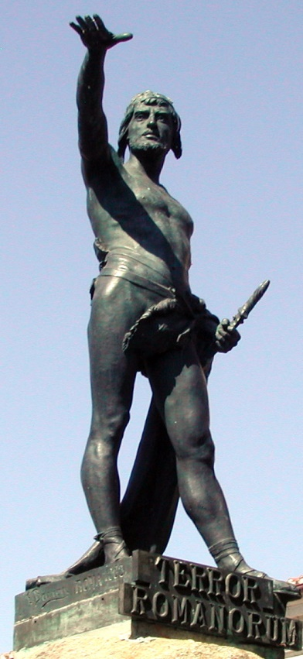
War in Spain
c. 155-133 BCE
Fought against Celtic inhabitants of inland Iberian peninsula (called ‘Celtiberians’)
Finally won by besieging Numantia
Very little booty to be had
Viriatus, leader of the Celtiberians

Slide 11
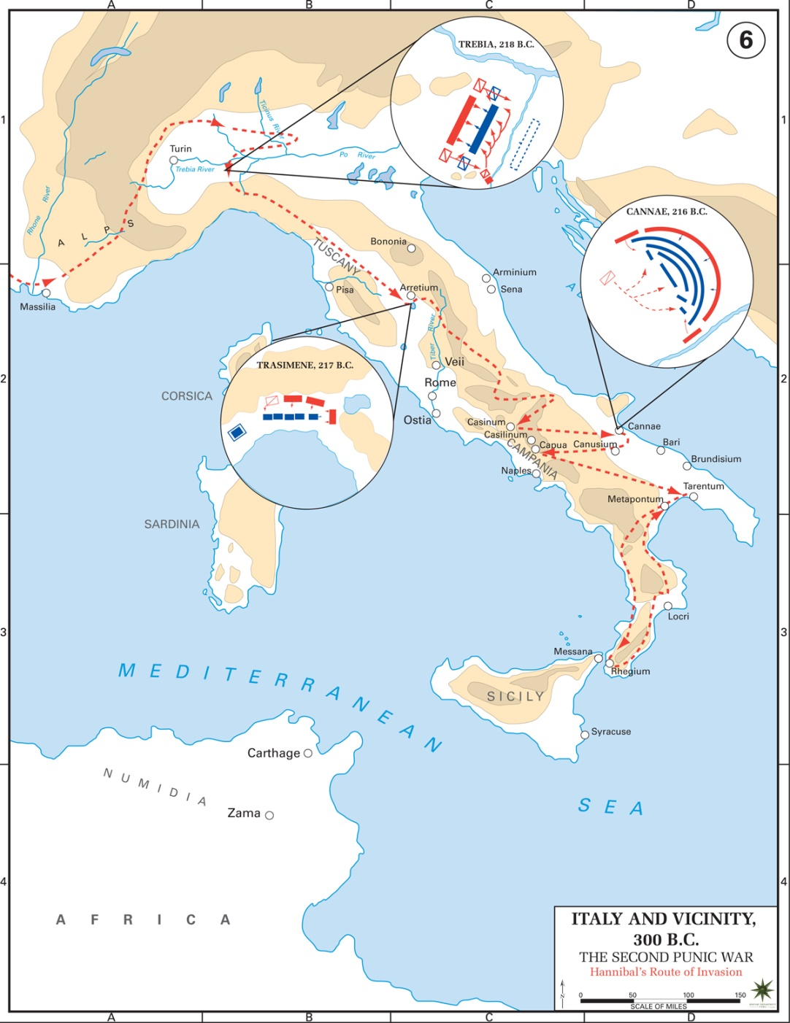
Hannibal in Italy
Trebia (218)
Lake Trasimene (217)
Cannae (216)

Slide 12
Loss of Land
“But it was no easy matter for the people, since free farmers had been wiped out by the war, and there was a scarcity of slaves, while cattle had been stolen and farmhouses demolished or burned.”
- Livy 28.11

Slide 13
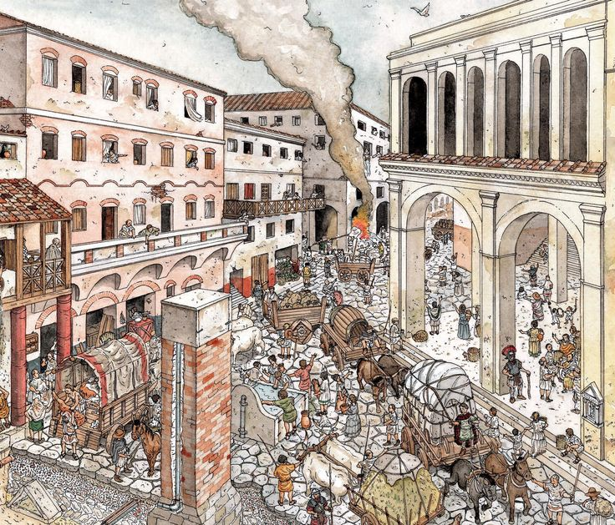
Immigration to Rome

Slide 14
Servius Tullius’ Army
Divisions of Roman male population:
100,000 asses (big bronze coins)
75,000 asses
50,000 asses
25,000 asses
11,000 asses
Threshold for fifth class reduced to 4000 asses during Second Punic War

Slide 15
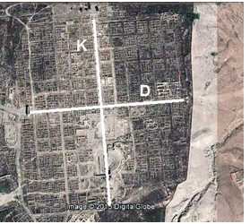
Centuriation

Slide 16
Colonies

Slide 17
Ager Publicus
= ‘public farmland’
Usually acquired as a result of conquest
Opened up for rental by citizens after the end of colonization in the first half of the 2nd cen. BCE
Theoretically limited to 500 iugera (125 hectares) per citizen
But many wealthy people held more than this, and farmed this land with slaves

Slide 18
Ager Publicus
*
“Later, however, their rich neighbors began to transfer the leases to themselves under fictitious names, and then end up by blatantly owning most of the land in their own names. The dispossessed poor lost any interest they might have had in performing military service, and could not even be bothered to raise children, with the result that before long there was a noticeable shortage of free men for hire, while the place was teeming with gangs of foreign slaves, whom the rich used to cultivate their land instead of the citizens they had driven away.”
- Plutarch, Tiberius and Gaius Gracchus 8

Slide 19
The Gracchi
Tiberius Sempronius Gracchus (163-133 BCE)
Gaius Sempronius Gracchus (c. 154-121 BCE)

Slide 20
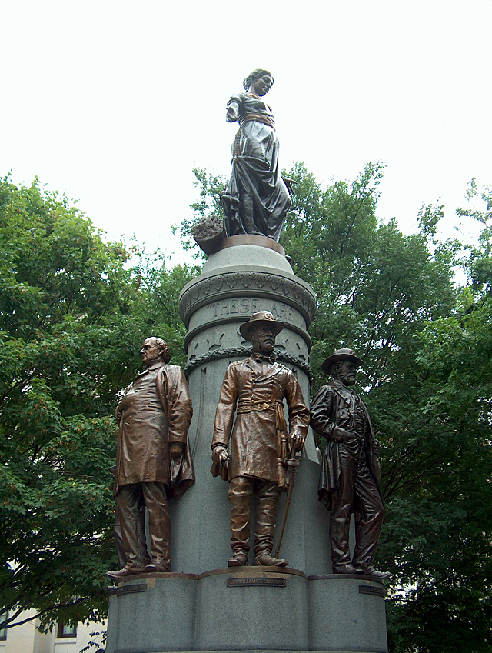
The Gracchi
Father: Tiberius Sempronius Gracchus (senior)
c. 217-154 BCE
Tribune in 187
Praetor in 179
Consul in 177
Censor in 169
Consul again in 163
Cornelia
Daughter of Scipio Africanus
Supposed refused a marriage proposal from King Ptolemy VIII of Egypt

Slide 21
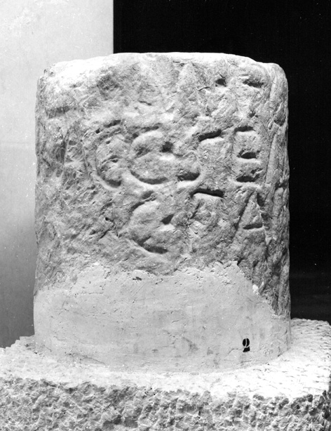
Tiberius Gracchus
Served in Third Punic War and in Spain in 137
Elected tribune in 133
Proposed a law to set up a commission to survey and redistribute the ager publicus
*
Boundary stone erected by Gracchus’ land commission, c. 131-125 BCE

Slide 22
Tribunes
Elected officers of the plebs
Sworn to protect the plebs against abusive magistrates
In return the plebs swore to protect the tribunes
Had veto power over the senate

Slide 23
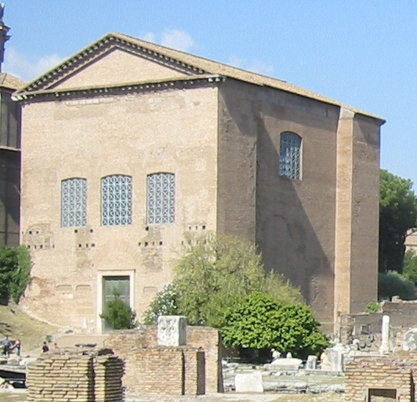
The Senate
From senex = ‘old man’
Believed to have been founded by Romulus
Originally an advisory body
Former magistrates became senators
Usually had to approve laws before they could be voted on by the assembly
Met in the Curia
The Curia Julia as restored in the 1930s

Slide 24
Tiberius Gracchus
Proposed his law directly to the plebeian assembly
Opposed by another tribune, Marcus Octavius
Tiberius had Octavius deposed by the plebs
Senate refused to fund the land commission
Tiberius proposed that Attalus III’s bequest of the kingdom of Pergamum be used instead
Stood for reelection as tribune in 132 BCE
*
Boundary stone erected by Gracchus’ land commission, c. 131-125 BCE

Slide 25
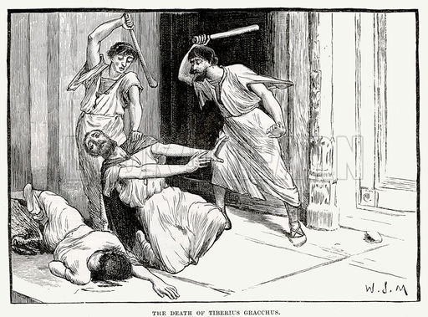
But…

Slide 26
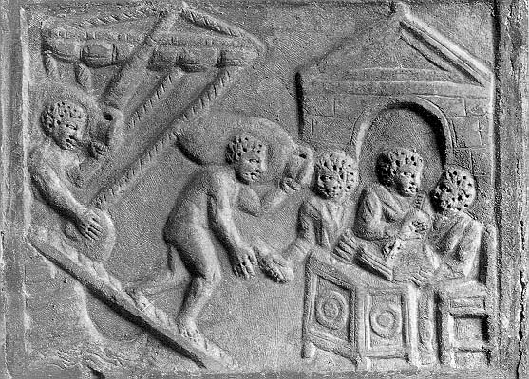
Gaius Gracchus
Served in Spain and Sardinia
Elected tribune in 123; reelected in 122
Proposed to reenact Tiberius’ land commission law
Established a grain dole in Rome for the urban poor
Farmed taxation of the province of Asia to the equestrians
Established special courts for extortion cases judged by equestrians
Proposed citizenship for Latins and Latin rights for Italians

Slide 27
Roman Social Orders
Patricians
Descendants of Romulus’ original 100 senators
Equestrians/Knights
Descendants of Servius Tullius’ original cavalry centuries
Consisted of those who could afford to maintain horses
Plebeians/Plebs
All other citizens

Slide 28
But…

Slide 29
Summary
Roman countryside depleted by:
Wars abroad
Immigration to Rome
Army recruitment suffered as a result
Colonization alleviated this somewhat
But the Italian peninsula was getting full
Tiberius Gracchus proposed opening up ager publicus to the people
Opposed by Senate and Marcus Octavius
Gracchus had Octavius deposed
Senate denied funded; Tiberius proposed using the Attalid bequest
Murdered by a group of senators
Gaius Gracchus proposed renewing the law
And created the grain dole, farmed out Asian tax collection, and established new courts
Murdered by the consul

Slide 30
Roman Political Factions
Optimates
Populares
Supporters of senatorial power
Usually members of the patrician class
Supporters of reforms favoring plebeian interests
Included many aristocrats and senators, as well as novi homines

Slide 31
Key Terms
Tiberius Gracchus
Gaius Gracchus
Plutarch
Census
Ager Publicus
Tribunes
Optimates
Populares

